Slide 1
V6 Customization
Lesson content:
  Chapter 1: Introduction
  Chapter 2: Environment Set up & BL Editor
  Chapter 3: BL for Initial Naming
  Chapter 4: BL for FBDI
  Chapter 5: BL customization for new V6 data model
  Chapter 6: Coming Next
Notes:
Copyright DASSAULT SYSTEMES

Slide 2
Introduction

Slide 3
Introduction
Object
  To customize naming during FBDI, a dedicated Business Logic is available on V6R2009x with the following action : “PLMImportExportAttributesValuation”
  The customization of “PLMIdentificationInitialization” is not required but if you want to get the behavior for the identification of a new VPM object you have to check if the rule for FBDI is identical.
  In this document, you will see
    How to set the environment to use customized Business Logic rules
    How to create, edit and check rules with the dedicated editor
    How to customize the Initial Naming BL rules
    How to customize the FBDI BL rules
    Why BL customization is required if a new Data model is deployed

Slide 4
Environment Set up & BL Editor

Slide 5
Environment Set up & BL Editor 1/2
Environment Set up for Business Logics customization
  To customize naming, specific Business Logics file have to be created in the “scripts” directory created in CATKnowledgePath directory to be execute instead the BL available in the code directory
    *.CATRuleExit to reference CATRule Scripts
    *.CATRule to create yours own rules
  In V6R2009x, a dedicated BL is used for FBDI. If it is used, it will replace the Initialization business logic rule.
    “PLMImportExportAttributesValuation”
  Paths to add in the environment file (ex :CATIAV6R2009x.B206.txt)
    CATKnowledgePath=C:\MyCusto\resources\knowledge;%CATKnowledgePath%
  Variables for Business Logics debugging
    CKE_CUSTO_TRACES=1 (To activate traces)
    CKE_CUSTO_DYNAMIC=1 (To allow change during the same session)
    CNEXTOUTPUT=console (or CNEXTOUTPUT=C:\...\OutputFile.log)
    NOTA : Using these variable is time consuming. Use them only for debugging tasks

Slide 6
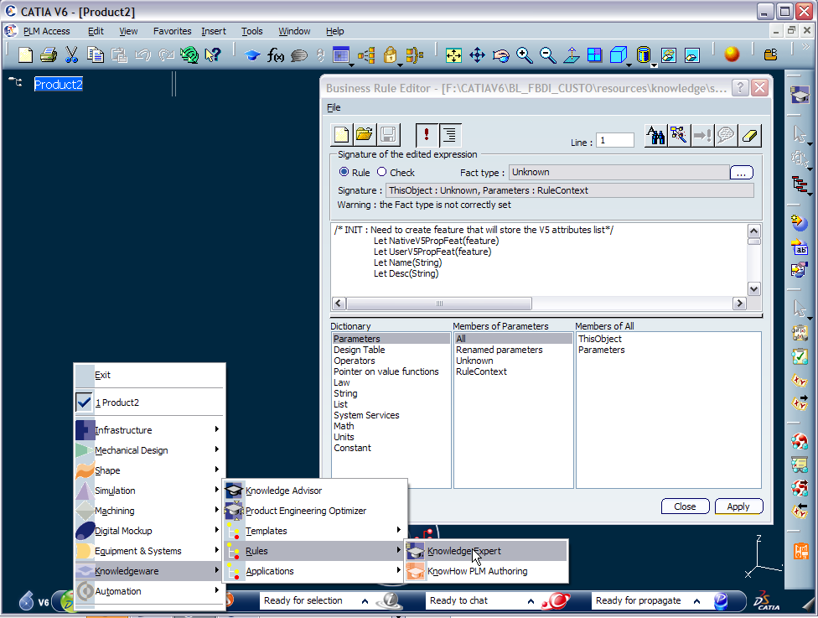
Environment Set up & BL Editor 2/2
A CATRule editor is available in the Knowledge Expert workbench
  A product must be create first
  WARNING : The advanced BL documentation is part on CAA documentation. This documentation is LA and it is not available on V6R2009x. It is candidate for V6R2010

Slide 7
BL for Initial Naming

Slide 8
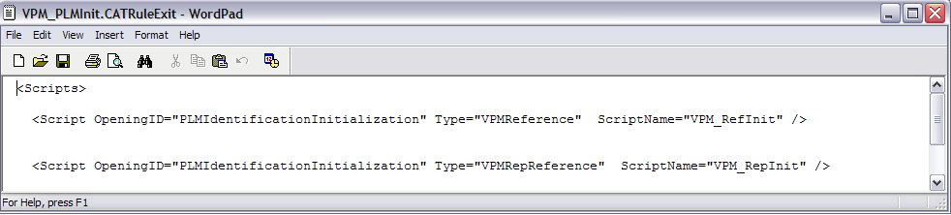
BL for Initial Naming 1/6
First, you have to create a CATRuleExit in the “script” directory to identify
  The action : OpeningID,
  The targeted object : Type
  The customized script : ScriptName
  No rule for CATRuleExit file naming
Sample for default environment “VPM”

Slide 9


BL for Initial Naming 2/6
Secondly, scripts “CATRule” have to be defined in the “script” directory
  For target objects, this rule has to define the naming for the following action (OpeningID) :
  If new object : “New”
  If imported object : “Implicit” (FBDI is not specific rule is deployed)
  If duplicate object : “Cloning”
  NOTA : If you use the default VPM data model, the standard CATRules located in the default knowledge Path must be renamed to avoid conflict. (ex : ..\B206\intel_a\resources\knowledge\scripts)

Slide 10
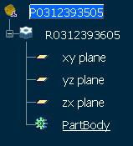
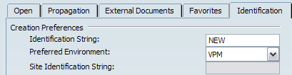
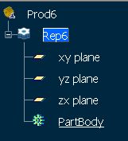
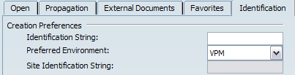
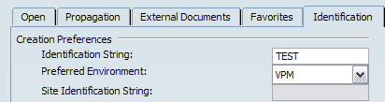
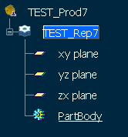
BL for Initial Naming 3/6
Sample of BL customized for the VPM environment “VPM_RefInit.CATRule”
  In this sample, the naming rule of this BL was created to be copy in the FBDI BL
  The main objective of this BL is to change the naming rules according the value of the identification string
  If “NEW” : new naming (to specify for different customers)
  If “ “ or “xxx” : identification + default naming

Slide 11
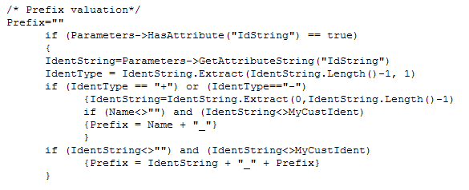
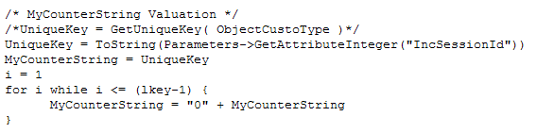
BL for Initial Naming 4/6
Sample of BL customized for the VPM environment “VPM_RefInit.CATRule”
  How to analyze Identification String
  How to create the Unique String

Slide 12
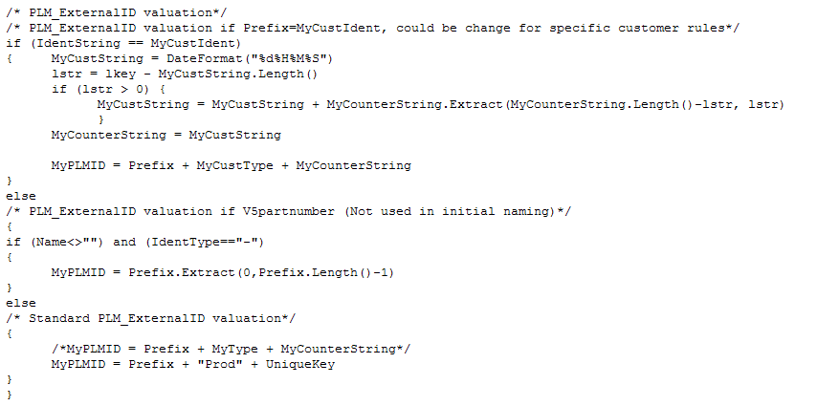
BL for Initial Naming 5/6
Sample of BL customized for the VPM environment “VPM_RefInit.CATRule”
  How to valuate PLMID according the Identification String value

Slide 13
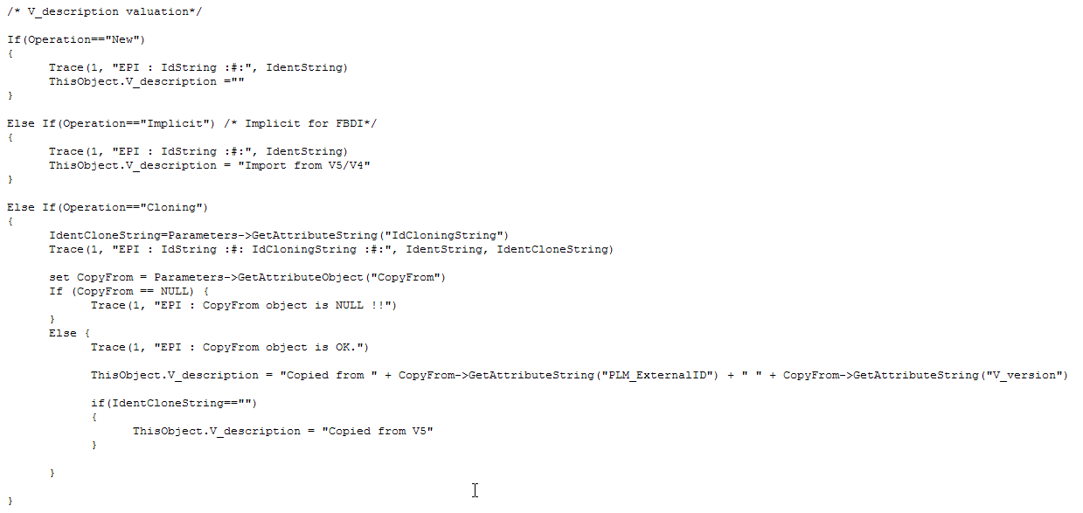
BL for Initial Naming 6/6
Sample of BL customized for the VPM environment “VPM_RefInit.CATRule”
  How to valuate Description according the Operation

Slide 14
BL for FBDI

Slide 15
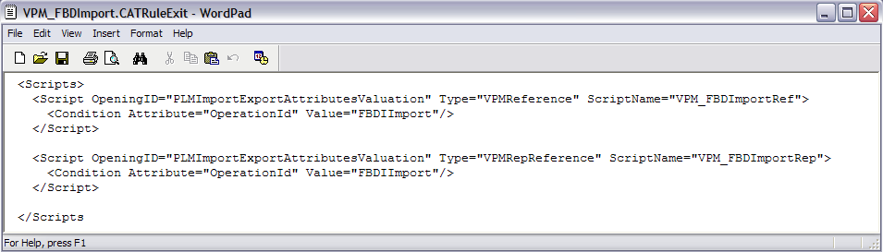
BL for FBDI 1/7
First, you have to create a CATRuleExit in the “script” directory to identify
  The action : OpeningID,
  The targeted object : Type
  The customized script : ScriptName
  The condition of use : Condition Attribute
  The value of condition : Value
  No rule for CATRuleExit file naming
Sample for default environment “VPM”

Slide 16
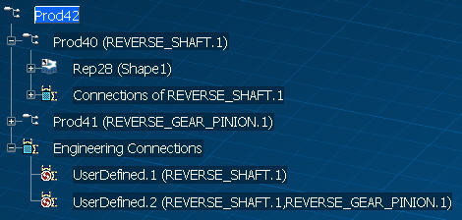
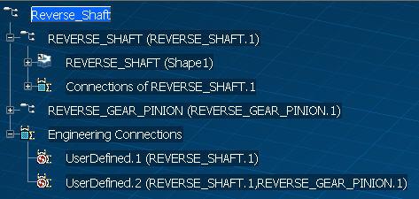
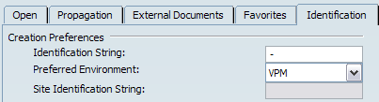
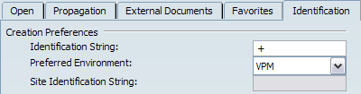
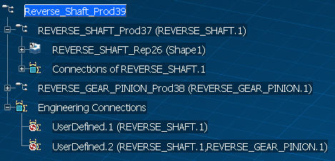
BL for FBDI 2/7
Sample of BL customized for the VPM environment “VPM_RefInit.CATRule”
  The main objective of this BL is to change the naming rules according the value of the identification string
  If “NEW” : new naming (to specify for different customers)
  If “+“or “XXX+”: : identification + V5/V4 name + default naming
  If “ ” or “XXX”: identification + default naming
  If “-“ or “XXX-”: identification + V5/V4 name

Slide 17
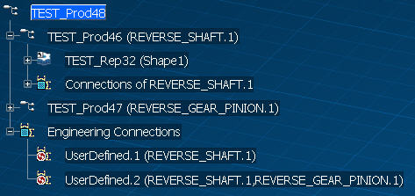
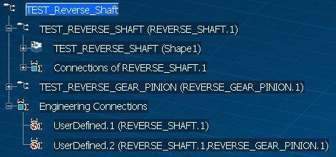
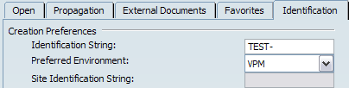
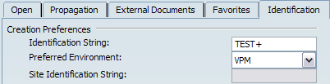
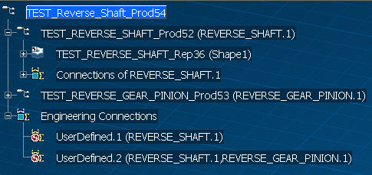
BL for FBDI 3/7
Sample of BL customized for the VPM environment “VPM_RefInit.CATRule”

Slide 18
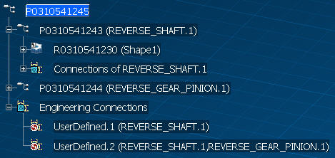
BL for FBDI 4/7
Sample of BL customized for the VPM environment “VPM_RefInit.CATRule”

Slide 19
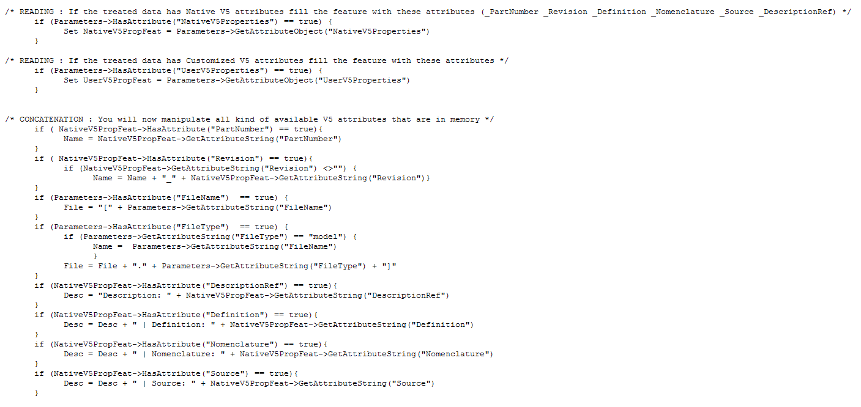
BL for FBDI 5/7
Sample of BL customized for the VPM environment “VPM_RefInit.CATRule”
  How to retrieve V5 properties

Slide 20
BL for FBDI 6/7
Sample of BL customized for the VPM environment “VPM_RefInit.CATRule”
  How to analyze identification String
  How to create the Unique String

Slide 21
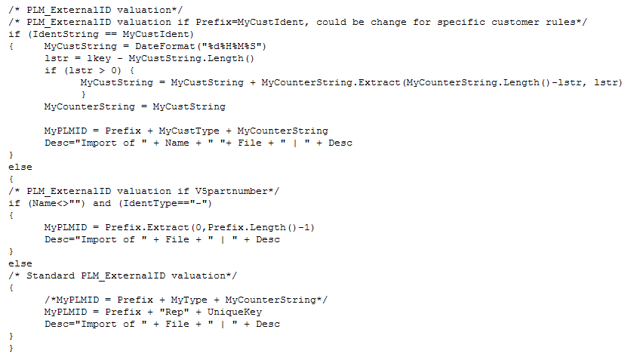
BL for FBDI 7/7
Sample of BL customized for the VPM environment “VPM_RefInit.CATRule”
  How to valuate PLMID and Description according the Identification String

Slide 22
BL customization for new V6 data model

Slide 23
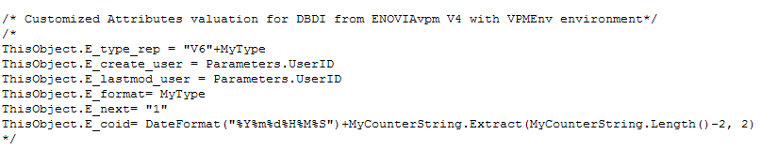
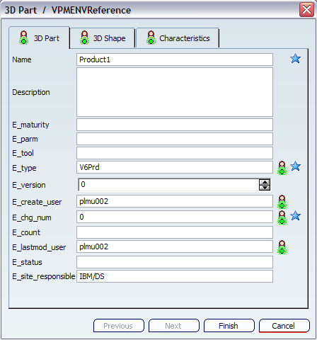
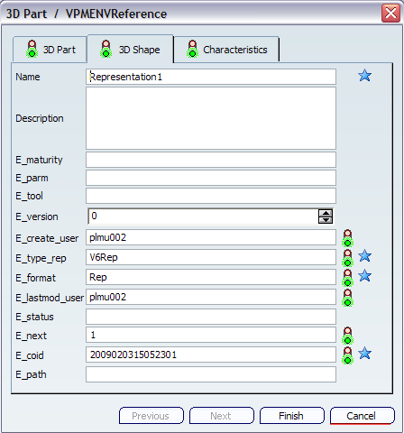
BL customization for new V6 data model
BL customization to valuate V6 VPM attributes
  If a customized data model is deployed new attributes could be automatically valuated
  Optional for Initial Naming
  Mandatory for FBDI (if no BL, data can not be imported)
  (See below valuation for data model deployed to exchange with VPM V4)

Slide 24
Coming Next

Slide 25
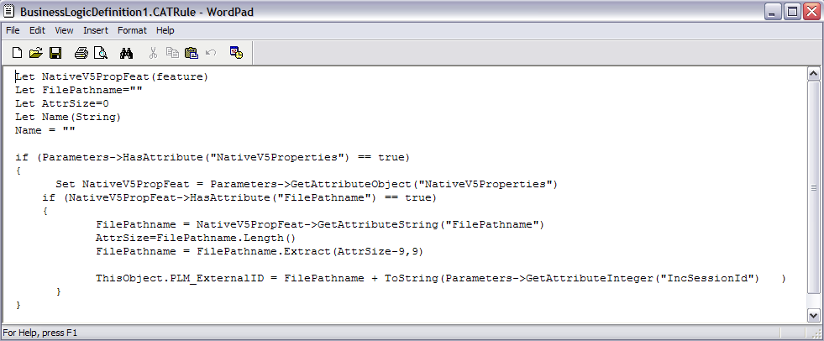
Coming Next
Candidate For V6R2010
  Support of Non-DS document for BL customization
    File name, without extension (example: toto)
    File type of the document being imported (example: doc)
    Properties, a list of attributes coming from the V5.The only property in this list is the file path and name (example: E:\toto.doc)

